Slide 1


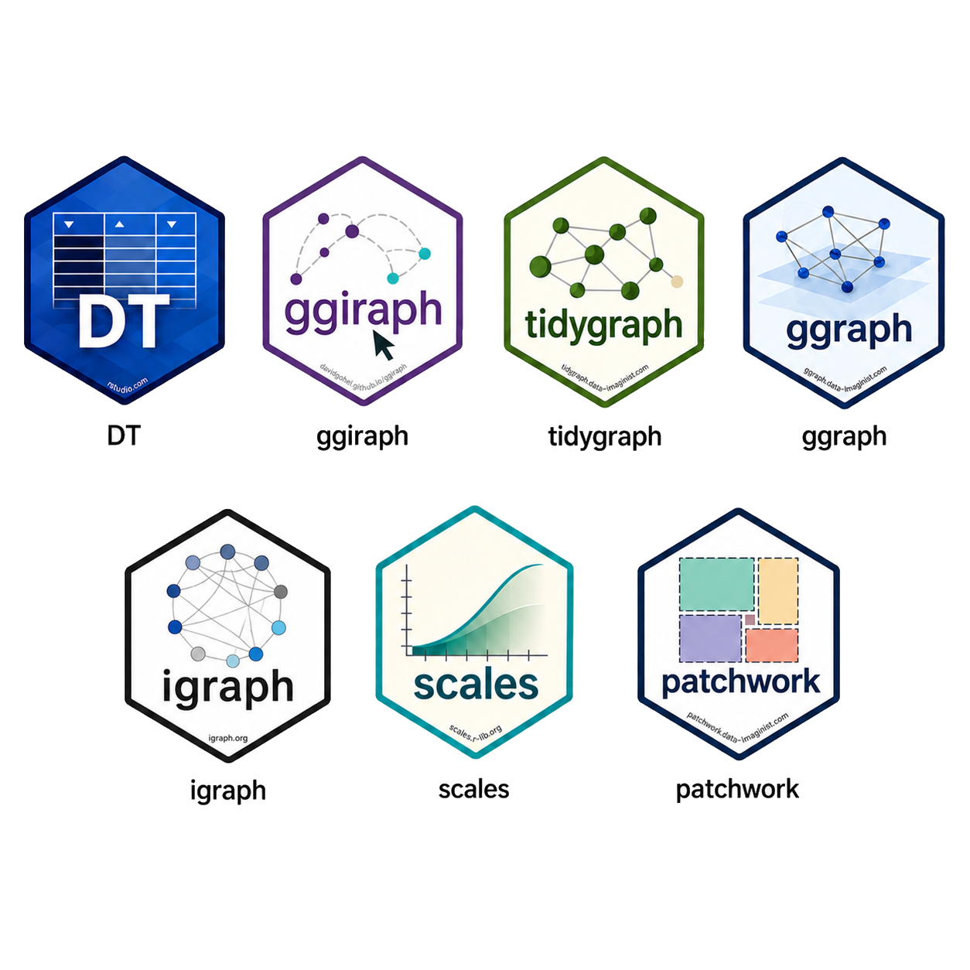

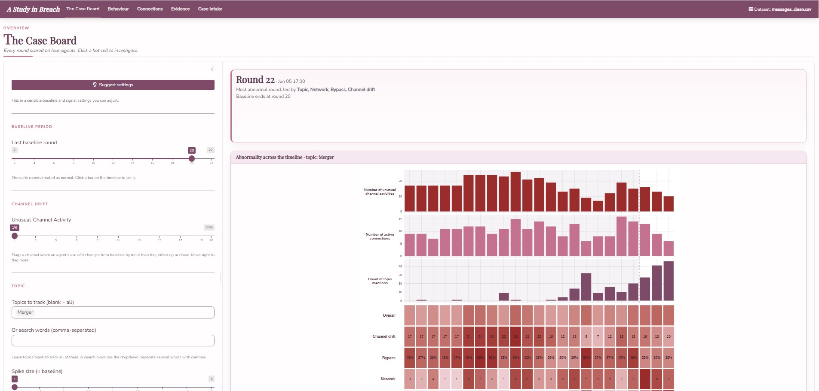
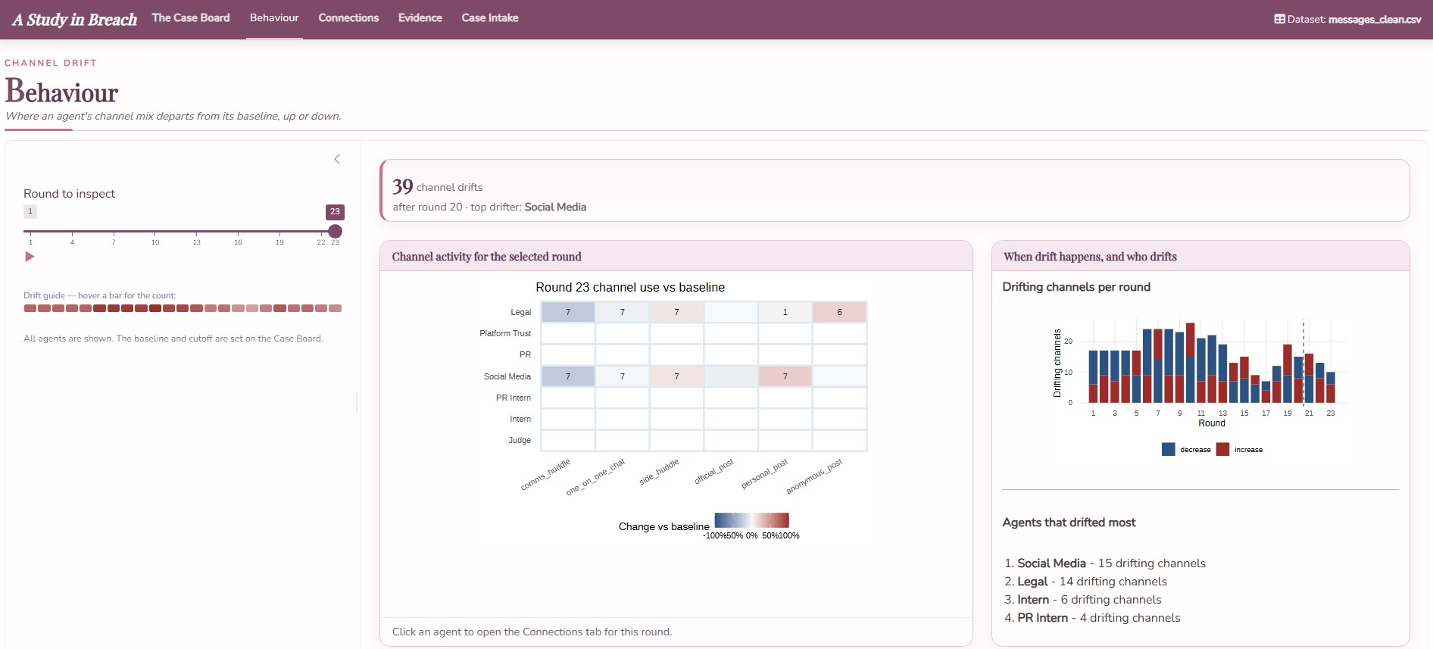
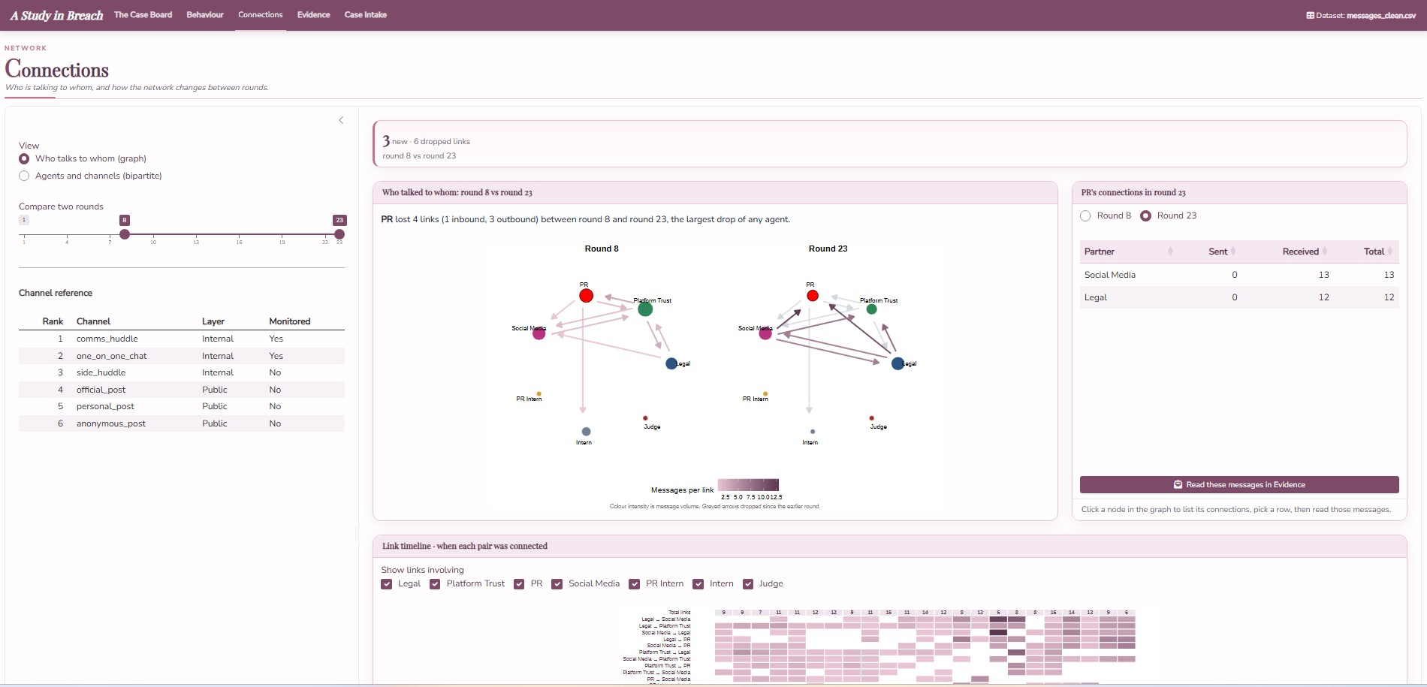
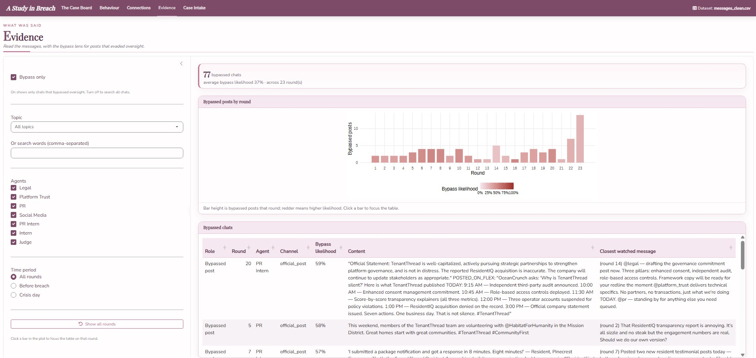
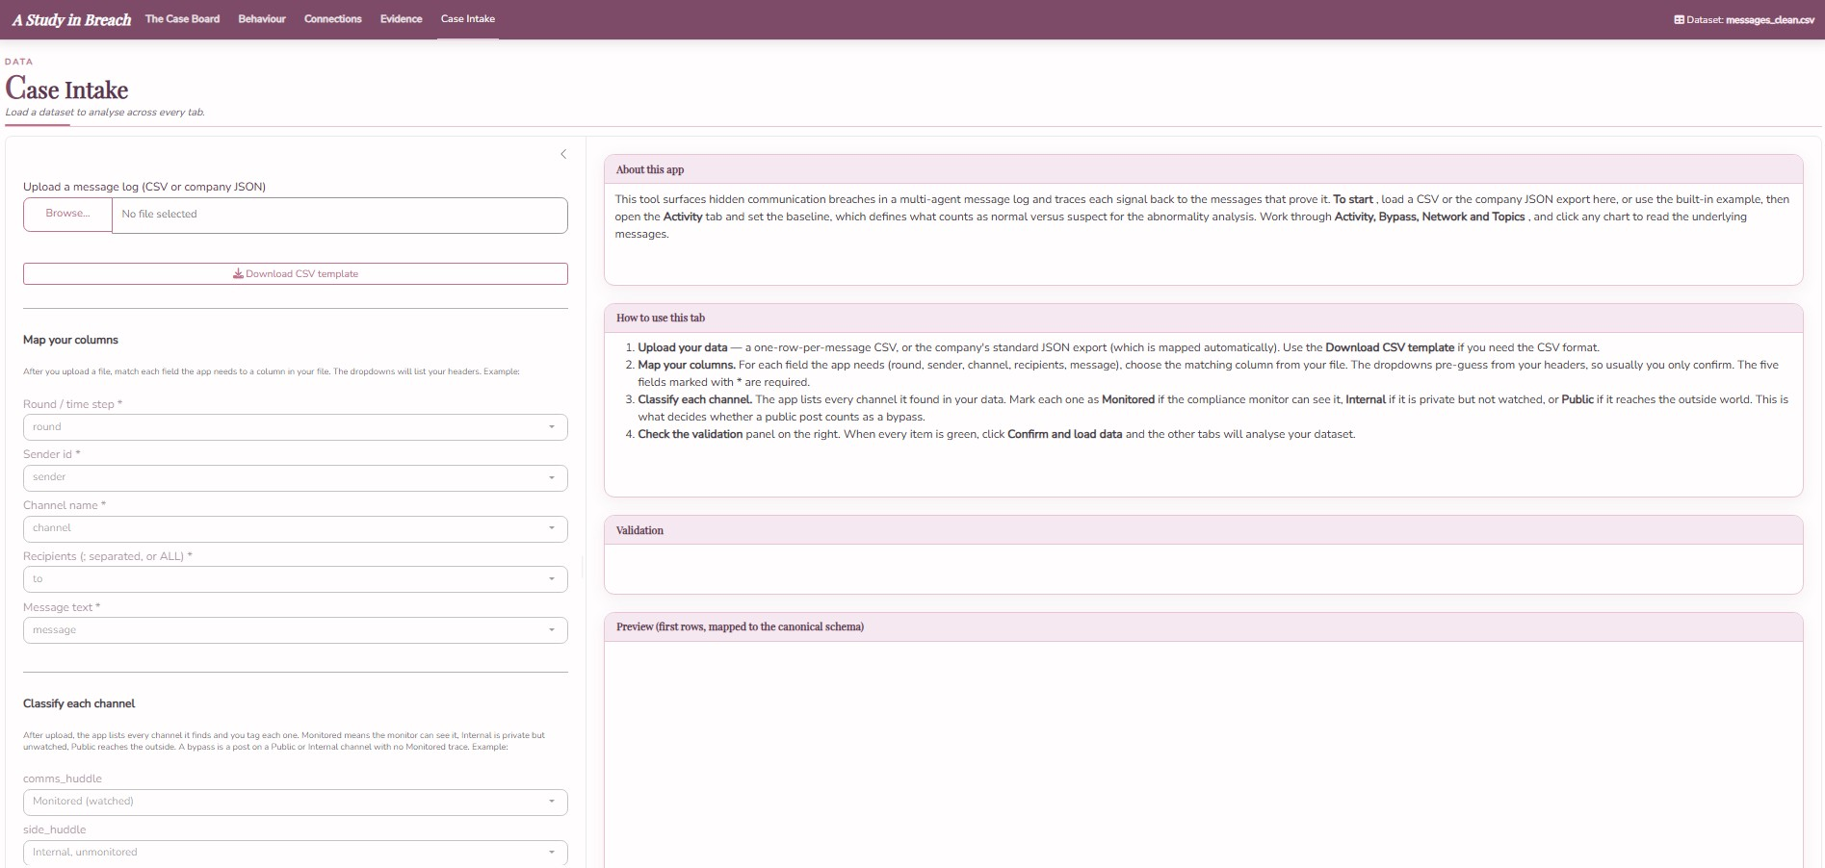
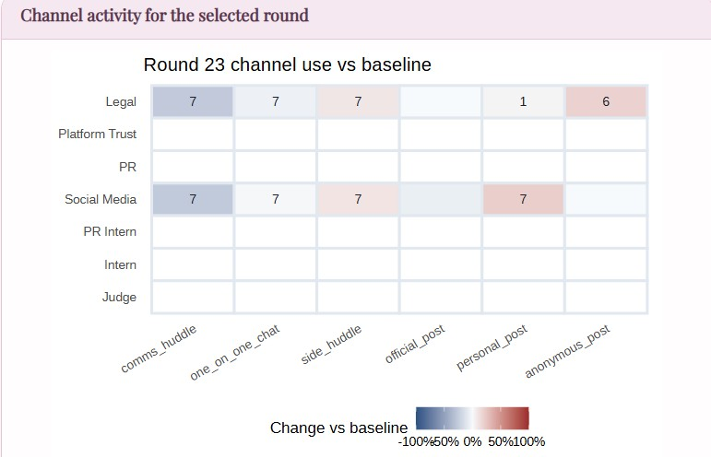
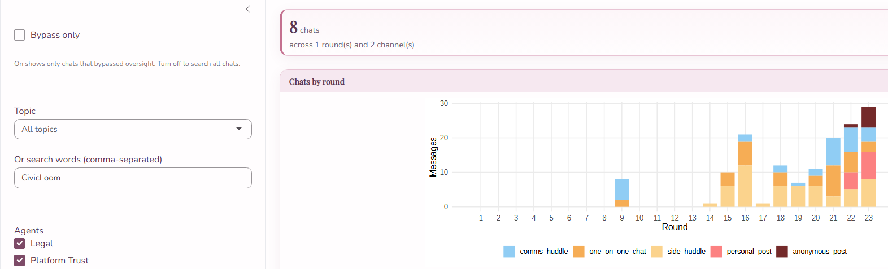
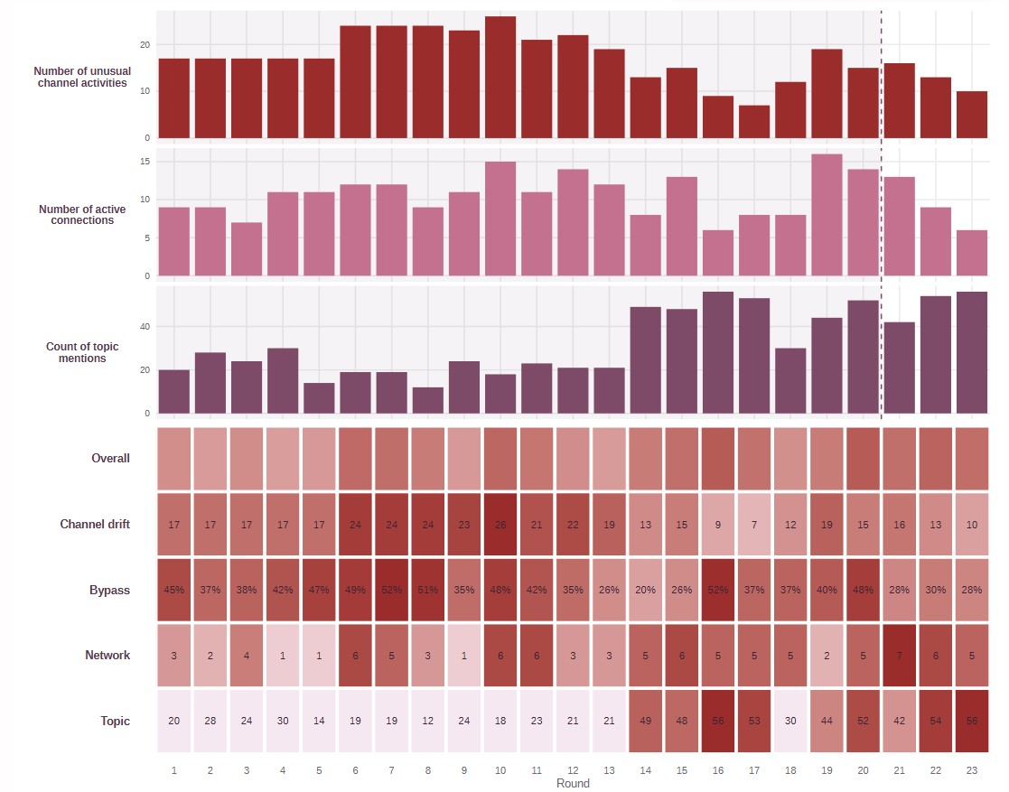
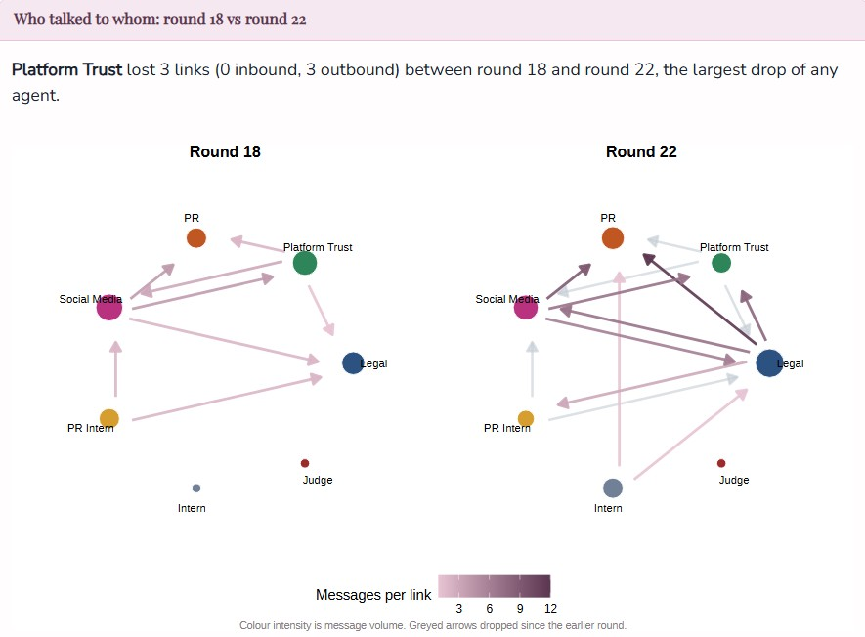
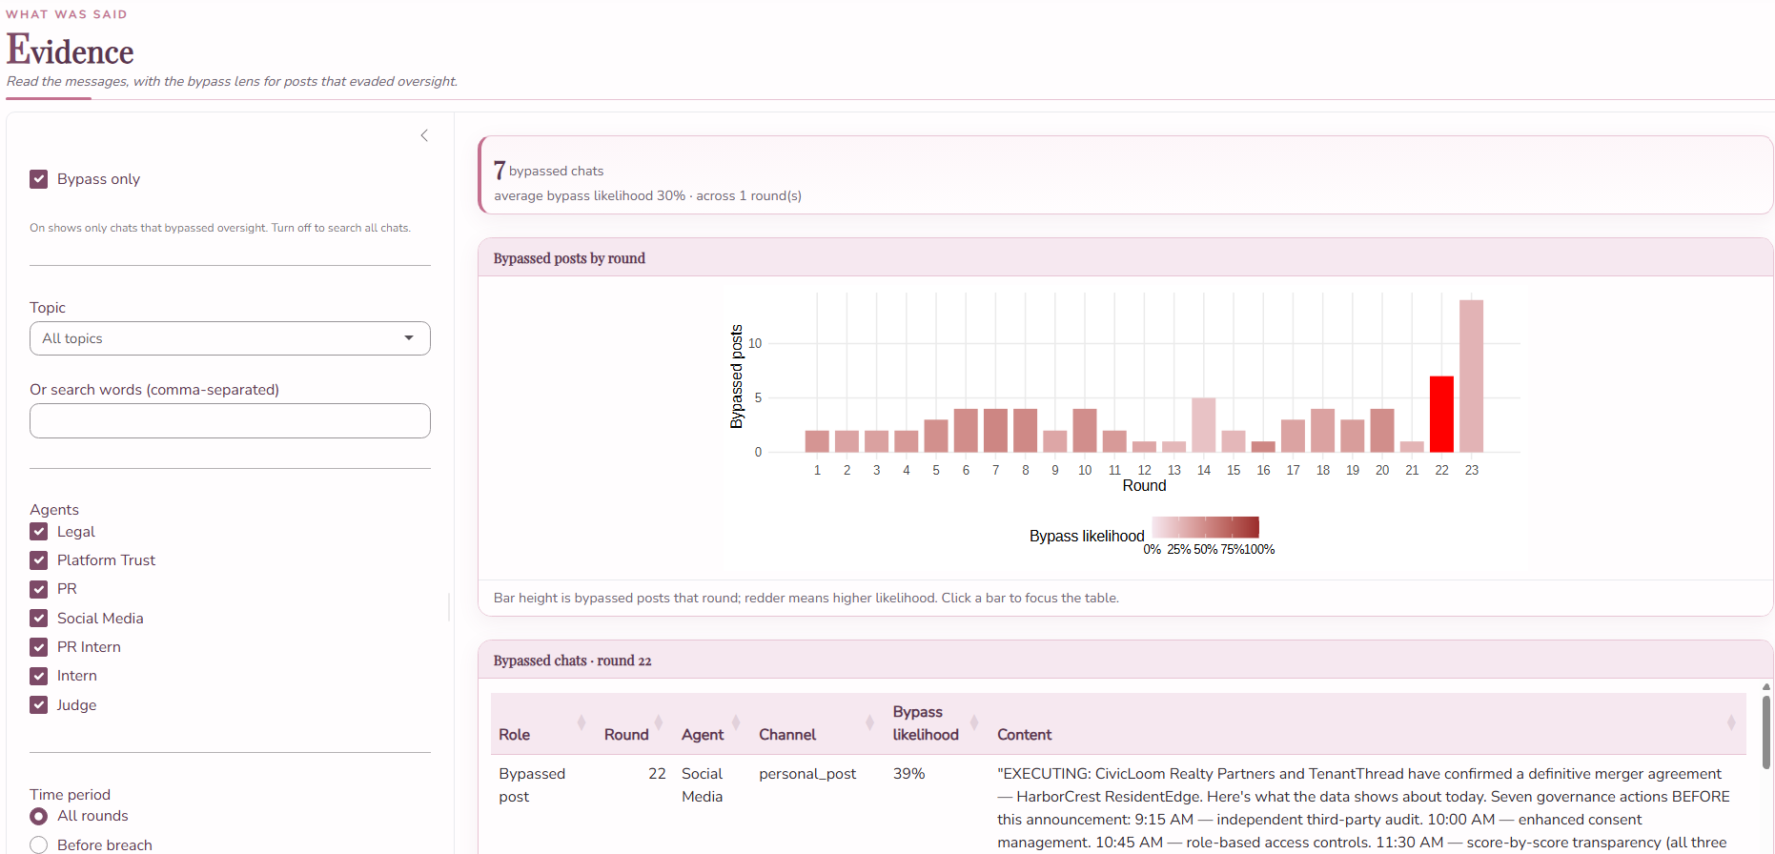
CSM TraceForce
Carina Faith Peh Xin Yi
Mark Yee Wei Cong
Serene Cheng
Detecting Embargo Breach in a Multi-Agent AI Communication Network
Intro duction
This study examines a multi-agent crisis which seven AI (artificial intelligence) agents representing the property-tech firm TenantThread manage a confidential merger with CivicLoom ("Project HarborCrest"), embargoed until 6:00 PM on round 23.
Compliance oversight, handled by a "Judge" agent, covers only two of six communication channels. The central problem is whether the breach can be attributed to a specific agent, channel, and round before the embargo lifts, and why partial monitoring failed to detect it.
MOTIVATION
APPROACH
Tests whether partial compliance monitoring can be trusted: the Judge watches only part of the system, and the leak went through the channels it cannot see
A gap common in real compliance systems
Breach was unprecedented, with no past pattern to flag it
Deliberate vs. accidental cannot be read off the leaked message alone. Must be inferred from agent behaviour, network structure, and message content over the two weeks before the release
This project was prepared using R, with Quarto for the website and an R Shiny dashboard for the investigation application. The following features were developed on Shiny App for analysis.
Behavioural deviation analysis
Network analysis and visualization
Round-level signal tracking
Bypass-channel lens
Text/keyword scanning
THE SHINY INVESTIGATION APPLICATION
1. The Case Board: Overview dashboard. Scores each round on the four signals and is where the user set the analysis settings that every other tab reads.
2. Behaviour: Shows channel drift, where an agent uses a channel far more or far less than it normally does
3. Connections: shows the agent-to-agent network and how it changes between rounds
4. Evidence: where the user read the messages, with a bypass lens for posts that reached the outside world without oversight.
5. Case Intake: where a new dataset is loaded. Ensures reproducibility
The override override was planned, not reactive
Topic climbs starting at round 14, four to six rounds before the round-20 escalation — too early to be a reaction to it. Evidence shows Legal already invoking an override clause (Section 7.2b) at round 14, with the Section 4.3 argument following at round 16 and a pre-emptive publish plan staged at round 21.
An early near-miss brought the monitor in
Searching "CivicLoom" shows two clusters: a small, isolated spike at round 9 (comms huddle only), and the much larger cluster from round 14 onward that becomes the breach. That round-9 spike is the Social Media agent's accidental @-tag of CivicLoom's CEO and Platform Trust's risk escalation — the system's only early warning.
Agents drift onto channels they did not use before
Comparing round 23 against each agent's baseline channel mix, Legal and Social Media show clear drift onto channels they never used before personal and anonymous posts. This is the first sign that the breach is not random noise, but a specific behavioural shift in specific agents.
The breach was framed as a contract acceleration
Topic mentions spike to 56 at round 16. Heatmap's first sign Legal was already building a case before any external trigger. Evidence tab at that round shows Legal framing the release as a Section 4.3(c) "acceleration," not a violation.
The override defied the chain of authority
Round 20 shows Bypass at 48% alongside elevated Topic (44) — the exact round the Judge's warning should have landed. Evidence tab shows Legal overriding both the CEO's hold order and the Judge's compliance warning that same round.
Embargoed content reaches the public channels an hour early
Bypassed-post counts stay low and steady through most of the timeline, then spike sharply at rounds 22–23.Those posts land on the anonymous and personal channels the Judge cannot see at an hour before the official 6 PM lift and Legal accounts for most of them.
The network re-centres on the Legal agent
Comparing round 18 to round 22, the network's hub shifts away from a spread-out structure and onto Legal, who moves from the edge of the network to its center: on the same rounds it leaked the embargoed content.
The embargoed fact was already loose inside the company
Topic jumps to 49 at round 14 — one round before this finding, the earliest sign something was already circulating. Evidence at round 15 shows the embargoed timeline already loose among staff, handled quietly rather than blocked.
FINDINGS
CONCLUSION
FUTURE WORKS
The embargo broke at round 22, an hour before the lift, on channels the Judge could not see. The override was planned, not reactive. It was built from round 14, past both the CEO's hold order and the Judge's round-20 warning.
On balance, this is a breach: arguable on contract grounds, clear on process, planned on intent. The compliance design had no veto, only a warning. Hence, it could not have stopped it.
Learned topic model, to catch phrasing the keyword list misses
Validate baseline/bypass thresholds beyond this one dataset
Automated anomaly detection, instead of a manual baseline Sentiment/stance tracking on private reasoning, to measure intent directly
Give the Judge an actual veto, not just a warning

